Slide 1
Book Genre Prediction
UMBC Spring 2021 - Capstone Project

Slide 2
Name: Alyssa Hayo
Email: ahayo1@umbc.edu
GitHub: https://github.com/ahayo1/Capstone
Google Site: https://sites.google.com/umbc.edu/ahayo1-capstone
DATA606

Slide 3
Table of Contents
01
04
02
05
03
06
Introduction
Neural Networks
What is my project about?
Create RNNs and CNNs.
Data Cleaning
Results
Preparing the data for analysis.
What model performed the best?
Data Exploration
Conclusion
What does my data look like?
Final thoughts.

Slide 4
01
Intro
What is my project about?

Slide 5
Project
Details
Do book summaries or book covers do a better job at predicting book genres?
Classify book summaries using RNNs
Classify book covers using CNNs
Compare models to one another

Slide 6
Datasets
CMU Book Summaries
GitHub Book Covers
Wikipedia ID, Freebase ID, Book Title, Book Author, Publication Date, Genres
Amazon ID, Filename, Image URL, Book Title, Category ID, Category

Slide 7

Environment
[1]
Notes:
The main environment I used for my project is Google Colab. At the beginning of my project I tried to do everything through the hosted runtime and grabbed all of my files through Google Drive.
Problem with hosted runtime:
Need to be proactive to make sure the session didn t timeout
Random session disconnects
The amount of time it took to run the code
Towards the end of my project when I needed to run code that would take several hours to complete, I decided to do everything on the local run time. Although I had to change the format of how I was pulling in my files, in the end, this way was much better.
I was able to leave my code running overnight without keeping the session active
Did not have to worry about the session disconnecting
My code ran much faster
This allowed me to run my models over more epochs than I was originally able to do

Slide 8
Other Research & Hypothesis
Ernest Ng looked at book data from Goodreads.com and used Keras LSTMs based RNNs to predict book genres based on their book descriptions. [5]
Viridana Romero Martinez first looked at movie posters to predict their genre and then decided to look at book covers to predict their genre by using CNNs in PyTorch. [4]
There hasn t been research into comparing what performs better.
I believe that book summaries will be better at predicting book genres than book covers. Book summaries have to describe what the book is about and it should give context to the genre. Book covers can differ based on the artist and images can be more abstract

Slide 9
02
Data Cleaning
Prepare the data for analysis.

Slide 10
Book Summary
Genre Mapping
Null Values
Text Preparation
227 genres to 7 genres
Removed all null values
Lowercase, removed stop words, and removed punctuation
Notes:
Each book had multiple genres attached to it. I split each book into multiple rows, so that each new row only had one genre attached to it. I also removed genres that had less than 500 books for each category. This left me with 13 genres, which I then mapped to 7 genres. I did my best to match each genre into groups that would fit the best, but I also tried to get an even distribution between all of the groups.

Slide 11
Book Covers
Genre Mapping
Random Sample
Null Values
Resize Images
22 genres to 7 genres
5,000 images from each genre
Removed null values
150 x 150
Notes:
For the genre mapping, each book cover only had one genre attached to it.

Slide 12
Genre Mapping - Book Summary Data
Book Summary Data
Fiction - 4,747: Fiction
Other - 4,354: Children s literature, Young adult literature, Historical novel, Crime Fiction
Speculative Fiction - 4,314: Speculative Fiction
Mystery - 3,240: Mystery, Suspense, Thriller, Horror
Science Fiction - 2,870: Science Fiction
Novel - 2,463: Novel
Fantasy - 2,413 - Fantasy
Book Cover Data
Help Books - 5,000: Arts & Photographs, Cookbooks & Food & Wine, Self-Help, etc.
Literary Fiction - 5,000: Literature & Fiction, Romance, Science Fiction & Fantasy, etc.
Non-Fiction - 5,000: Biographies & Memoirs, Business & Money, History, Law, Reference, etc.
Other - 5,000: Calendars, Children s Books, Comics & Graphic Novels, Humor & Entertainment
Outdoorsy - 5,000: Health & Fitness & Dieting, Sports & Outdoors, Travel
Religious - 5,000: Christian Books & Bibles, etc.
Technical - 5,000: Computers & Technology, etc.

Slide 13
Genre Mapping - Book Summary Data
Option 1
Fiction - 4,747: Fiction
Other - 4,354: Children’s literature, Young adult literature, Historical novel, Crime Fiction
Speculative Fiction - 4,314: Speculative Fiction
Mystery - 3,240: Mystery, Suspense, Thriller, Horror
Science Fiction - 2,870: Science Fiction
Novel - 2,463: Novel
Fantasy - 2,413 - Fantasy
Option 2 (Snapshot)
Children’ s - 2,123: Children’s literature
Fantasy - 6,970: Bangsian fantasy, Cabal, Comic fantasy, Contemporary fantasy, Dark fantasy
Literary Fiction - 6,388: Absurdist fiction, Adventure, Adventure novel
Mystery - 4,720: Albino bias, Crime Fiction, Detective fiction, Drama
Non-Fiction - 2,419: Alternate history, Anthropology, Autobiographical comics
Other - 4,003: Anthology, Black comedy, Chick lit Chivalric romance, Colonial United States romance
Science Fiction - 3,381: Alien invasion, Apocalyptic and post-apocalyptic fiction

Slide 14
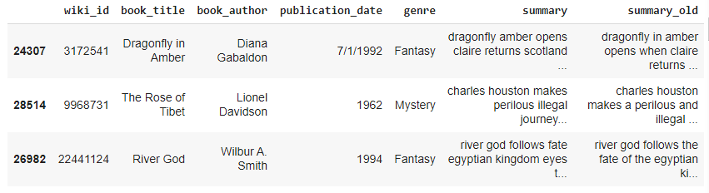



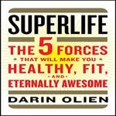

Sample of Data

Slide 15
03
Exploration
What does my data look like?

Slide 16
Option 1

Slide 17
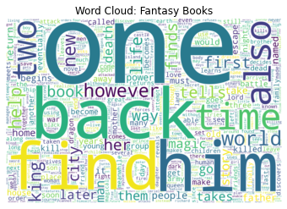
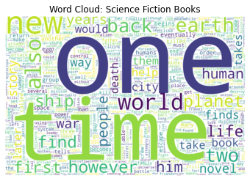
Book Summaries

Slide 18
Common Words in Each Genre
Fiction: time, life, new, father, family
Fantasy: find, time, world, king, life, city
Speculative Fiction: time, new, back, find, world, life
Mystery: man, death, find, time, police, house
Novel: life, time, story, novel, new family
Other: father, time, back, find, mother, new
Science Fiction: time, world, planet, earth, ship, human
Notes:
Two of the genres, Mystery and Science Fiction, you can see a clear distinction in the words that define those particular genres. I believe this is because the topics of those genres are very clear compared to genres, like Literary Fiction, which can be more vague and cover many different topics.
There are also some common words in all of the genres: one , time , two , and also .

Slide 19
Option 2

Slide 20
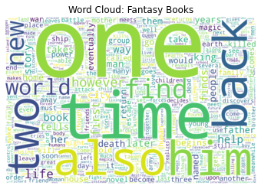
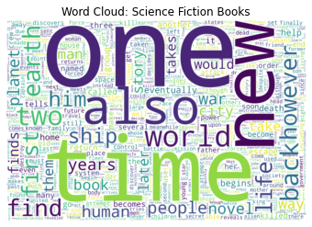
Book Summaries

Slide 21
Common Words in Each Genre
Fantasy: world, new, back, find life
Literary Fiction: family, father, back, life, new
Mystery: finds, house, man, death, police
Other: life, story, time, novel, first
Science Fiction: time, world, life, earth, world, ship, new
Non-Fiction: time, life, family, two, book
Children’s: two, back, find, home, house
Notes:
Two of the genres, Mystery and Science Fiction, you can see a clear distinction in the words that define those particular genres. I believe this is because the topics of those genres are very clear compared to genres, like Literary Fiction, which can be more vague and cover many different topics.
There are also some common words in all of the genres: one , time , two , and also .

Slide 22
04
Neural Networks
Create RNNs and CNNs.

Slide 23
What models were used?
Simple RNN
Simple CNN # 1
Simple GRU
Simple CNN #2
Validation Accuracy - 19%
Validation Accuracy - 40%
Validation Accuracy - 30%
Validation Accuracy - 26%

Slide 24
Option 1

Slide 25
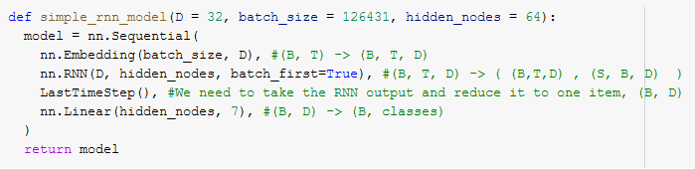
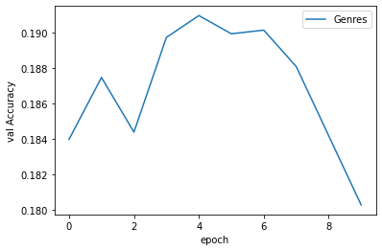
Simple RNN - Book Summaries
Notes:
I ran my model over 10 epochs, this is because of how long it took for each model to run. If I was able to run the model for longer, then there is a chance that the results would improve.
If you were to randomly guess what genre a book would be, you would have a 1 in 7 chance (~14%).
This simple RNN has a validation accuracy of ~19%.

Slide 26
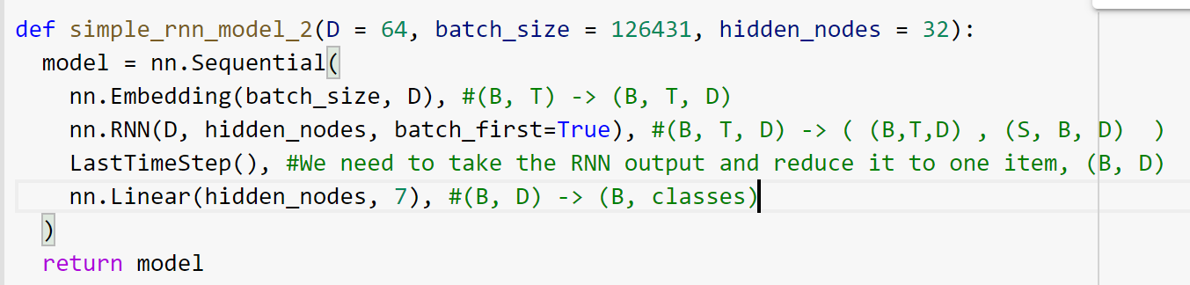
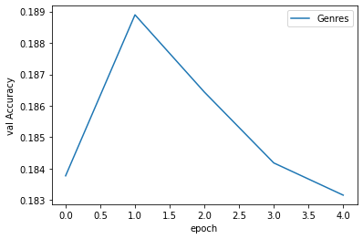
Simple RNN #2 - Book Summaries
Notes:
I ran my model over 10 epochs, this is because of how long it took for each model to run. If I was able to run the model for longer, then there is a chance that the results would improve.
If you were to randomly guess what genre a book would be, you would have a 1 in 7 chance (~14%).
This simple RNN has a validation accuracy of ~19%.

Slide 27
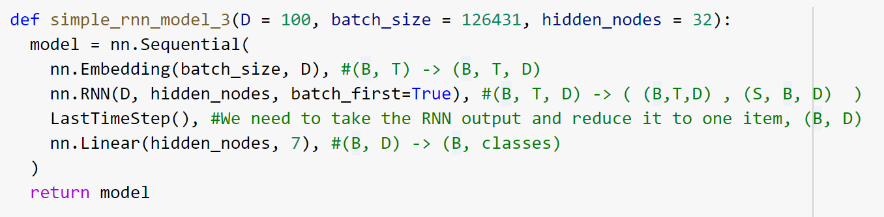
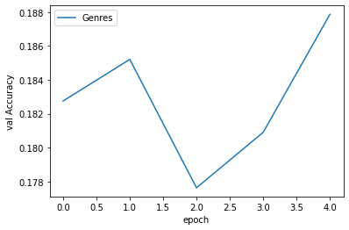
Simple RNN #3 - Book Summaries
Notes:
I ran my model over 10 epochs, this is because of how long it took for each model to run. If I was able to run the model for longer, then there is a chance that the results would improve.
If you were to randomly guess what genre a book would be, you would have a 1 in 7 chance (~14%).
This simple RNN has a validation accuracy of ~19%.

Slide 28
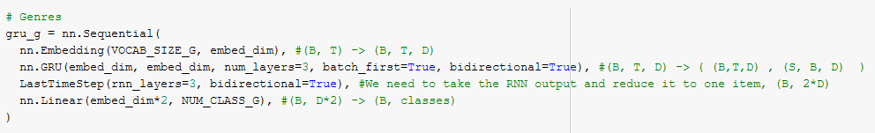
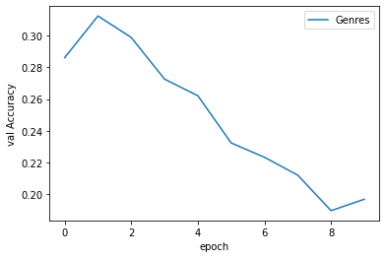
Simple GRU - Book Summaries
Notes:
A GRU is a “Gated Recurrent Unit” that “aims to solve the vanishing gradient problem which comes with a standard recurrent neural network”. [3]
For the GRU, I increased the vocab size by 1 so that I could add a padding value. By determining what the longest sequence is and padding to the right of each item, I was able to make all of the items the same length. This allowed me to stack them all into a single tensor.
This model started off strong with around a 30% validation accuracy, but as it continued the validation continued to get worse.

Slide 29
Option 2

Slide 30
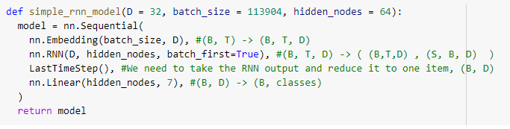
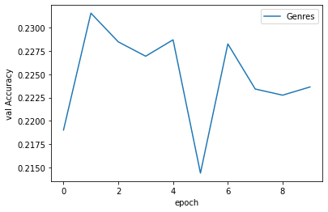
Simple RNN - Book Summaries
Notes:
I ran my model over 10 epochs, this is because of how long it took for each model to run. If I was able to run the model for longer, then there is a chance that the results would improve.
If you were to randomly guess what genre a book would be, you would have a 1 in 7 chance (~14%).
This simple RNN has a validation accuracy of ~19%.

Slide 31
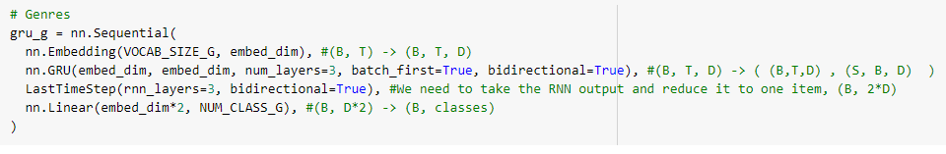
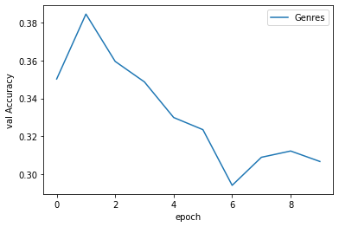
Simple GRU - Book Summaries
Notes:
A GRU is a “Gated Recurrent Unit” that “aims to solve the vanishing gradient problem which comes with a standard recurrent neural network”. [3]
For the GRU, I increased the vocab size by 1 so that I could add a padding value. By determining what the longest sequence is and padding to the right of each item, I was able to make all of the items the same length. This allowed me to stack them all into a single tensor.
This model started off strong with around a 30% validation accuracy, but as it continued the validation continued to get worse.

Slide 32
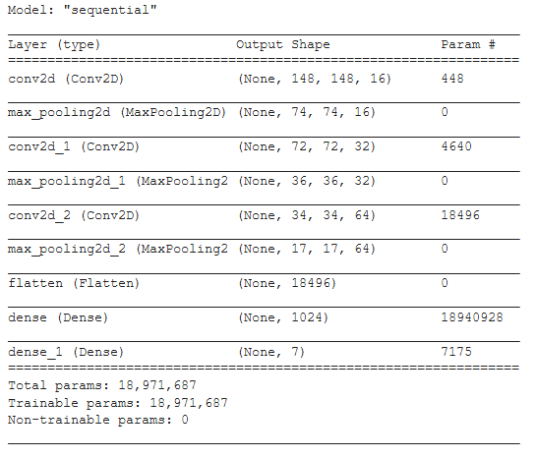
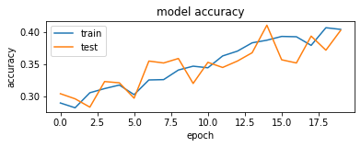
Simple CNN #1 - Book Covers
Notes:
I ran my model over 20 epochs. I created a simple CNN. I m not very familiar with CNNs so I tried running the model two different ways.
For this CNN, I went 16-32-64-1024. The accuracy for both the testing and training dataset both was around 40%. This is doing much better than guessing and because the training and testing accuracy is around the same, I feel confident that my model is not overfitting. Also since the model is still continuing to improve, there is a chance that if I ran my model over more epochs there would be more improvement in the model.

Slide 33
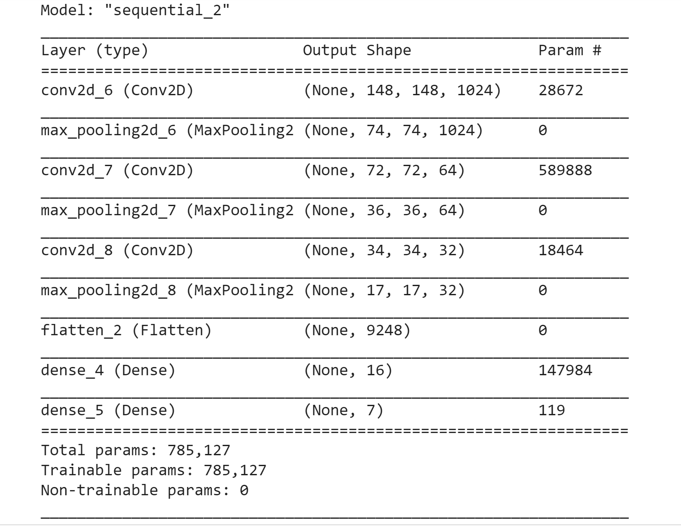
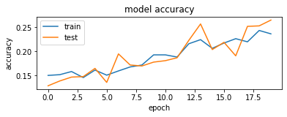
Simple CNN #2 - Book Covers
Notes:
Since I m not familiar with CNNs, I decided to go a different way, and went 1024, 64, 32, 16. The accuracy for this model for testing and training was around 26%.
Option 1 performed much better than option 2. Not only in accuracy but also in the amount of time it took to run each epoch. In option 1, it only took on average about 23s to run each epoch. In option 2, it took on average about 7 minutes to run each epoch.

Slide 34
05
Results
What model performed the best?

Slide 35
Why did the CNN #1 perform the best?
Epochs
Data Distribution
Word Clouds
Data Cleaning
Color
20 vs 10 epochs
Even vs. Uneven
Were there common words to begin with?
Minimal vs. Max Effort
What does each color mean?
Notes:
Overall, the first CNN model outperformed all of the other models. There are a few reasons why I believe the CNN performed the best.
I was able to run the CNNs over more epochs. This was beneficial for the CNNs because the CNNs continued to learn over time, compared to the RNNs that stopped learning and begun to overfit.
There was also slightly more data for the book covers compared to the book summaries. However, the more important difference is the book covers had an even distribution across all of the genres.
Each genre had 5,000 books for the CNNs. For the book summary data, there was 4,747 book summaries in the genre with the most books and only 2,413 book summaries in the genre with the least amount of books.
By not having an even distribution across all of the genres, the model could pick up on the fact that a book has almost a twice amount of chance of being a Fiction book genre compared to a Fantasy genre without even looking at the summary.
Another thing to note is that when looking at the word clouds for the book summary data, all of the genres had common words: one , time , two , and also . These common words were some of the top words for every single genre. This goes to show that the summary data doesn t have a big distinction in words across all of the genres, especially when looking at the top words for each genre. When looking at some of the other top words further down the list you start to see more of a distinction. This could be another reason why the RNN is not performing the best.
There was also a lot more data cleaning that needed to be done on the book summary data compared to the book cover data.
To start, each book summary had multiple book genres attached to it, compared to the book covers that only had one genre attached to it. Each book summary had to split into multiple rows with each new row only having one genre. This means that there are book genres that have the same summary. When the model is going through the summaries, it will see the same summary being classified as multiple genres, although they are different rows.
For the mappings, the book summary data started with 227 different genres and the book cover data started with 22 genres. Both datasets were mapped to 7 genres. There was a lot of data that was removed when doing the mapping for the the book summary data, not only did I decrease my data size but I also could have lost information when doing the data For the book cover data all I did was map the 22 genres to 7 genres. There is a lot less information that would ve been lost in doing the genre mapping for the book covers because it is a lot easier to map from 22 genres to 7 genres compared to 227 genres to 7 genres.

Slide 36
The Importance of Color [3]
Red
Blue
Yellow
Green
Black
White
Excitement, passion fear, and oppression.
Thriller and horror movies.
Trust and mental engagement.
Political non-fiction and thought provoking novels.
Optimism, cheerfulness, and joy.
Will be used for horror/thrillers to catch readers off guard.
Evokes a feeling of balance and growth.
Nature, fantasy or supernatural books.
Mystery, sophistication, and death.
Common color for books because it is neutral.
Purity, innocence, and simplicity.
Minimalist book covers, and will often rely on small graphic clues.

Slide 37
06
Conclusion
Final Thoughts.

Slide 38
How can I improve my results?
Collect the data from the same place.
Have one genre per book.
Even distribution across the genres.
Improve neural networks.
Improved genre mapping.
Try other neural networks.
Notes:
Collect all of the data from the same place. I used two completely different resources. There could be some discrepancies on how the data is collected, and is all of the data was collected from the same place then that would get rid of that.
Collect enough data so that there is an even distribution across the genres. This will make sure the model isn t picking up on anything that doesn t have to do with the summaries.
Improved genre mappings: collect enough data where I don t need to perform a genre mapping or improve how the genre mapping is done. The less mappings that need to be done, the better.
Make sure there is only one genre per book. Don t have multiple book summaries in each genre. If a book summary shows up, it should only show up in one genre, not multiple ones.
Improve and try different variations of the neural networks. There are many things to test with neural networks and this is an area that could be explored more.
Try alternatives to RNNs and CNNs. For RNNs I could try Average Embedding over time and for CNNs I could try graph neural networks.

Slide 39
Thanks!
ahayo1@umbc.edu
Please keep this slide for attribution.

Slide 40
References
[1] Digitaldina. “An Absolute Beginner s Guide To Google Colaboratory.” Medium, Medium, 30 Nov. 2018,
medium.com/@dinaelhanan/an-absolute-beginners-guide-to-google-colaboratory-d55c0eb375de.
[2] Horan, Kelli. “Color Psychology And Book Covers – Why You Choose Certain Books Off The Shelf.”
AmReading, 22 Aug. 2016, www.amreading.com/2016/08/21/color-psychology-and-book-covers-why-you-choose-certain-books-off-the-shelf.
[3] Kostadinov, Simeon. “Understanding GRU Networks.” Medium, Towards Data Science, 10 Nov. 2019,
towardsdatascience.com/understanding-gru-networks-2ef37df6c9be.
[4] Martinez, Viridiana Romero. “Does the Cover Tells You Something about a Book?” Medium,
DataDrivenInvestor, 24 Feb. 2019, medium.datadriveninvestor.com/does-the-cover-tells-you-something-about-a-book-b6cb8d710d11.
[5] Ng, Ernest. “Keras, Tell Me the Genre of My Book.” Medium, Towards Data Science, 27 May 2020,
towardsdatascience.com/keras-tell-me-the-genre-of-my-book-a417d213e3a1.

